Slide 1
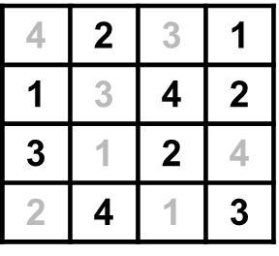
Challenge Solutions
MISSING SYMBOL: Each symbol is associated with another symbol’s position, the upside-down club is always to the left of the right-side-up heart.
TRIANGLES: 27 triangles. There are 16 one-cell triangles, 7 four-cell triangles, 3 nine-cell triangles, and 1 sixteen-cell triangle.
WORLDLES:
SUDUKO:
All hands on deck | Side by Side | Hitting below the belt
Thumbs Up | Just between you and me | Big deal
Mind over Matter | I understand | Coffee break
OTHER WORD CHALLENGES: Solutions and responses will vary. The key is that some people are very comfortable and skilled with certain kinds of questions and problems (and enjoy them), while others may feel totally at a loss for what is expected and not want to do them.

